Slide 1
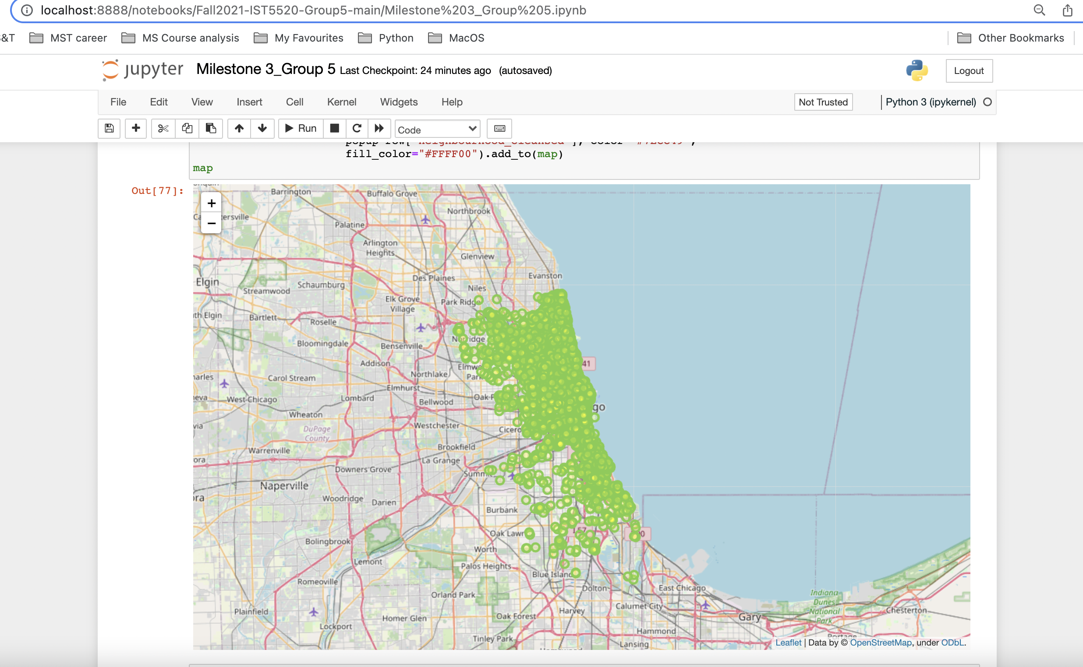
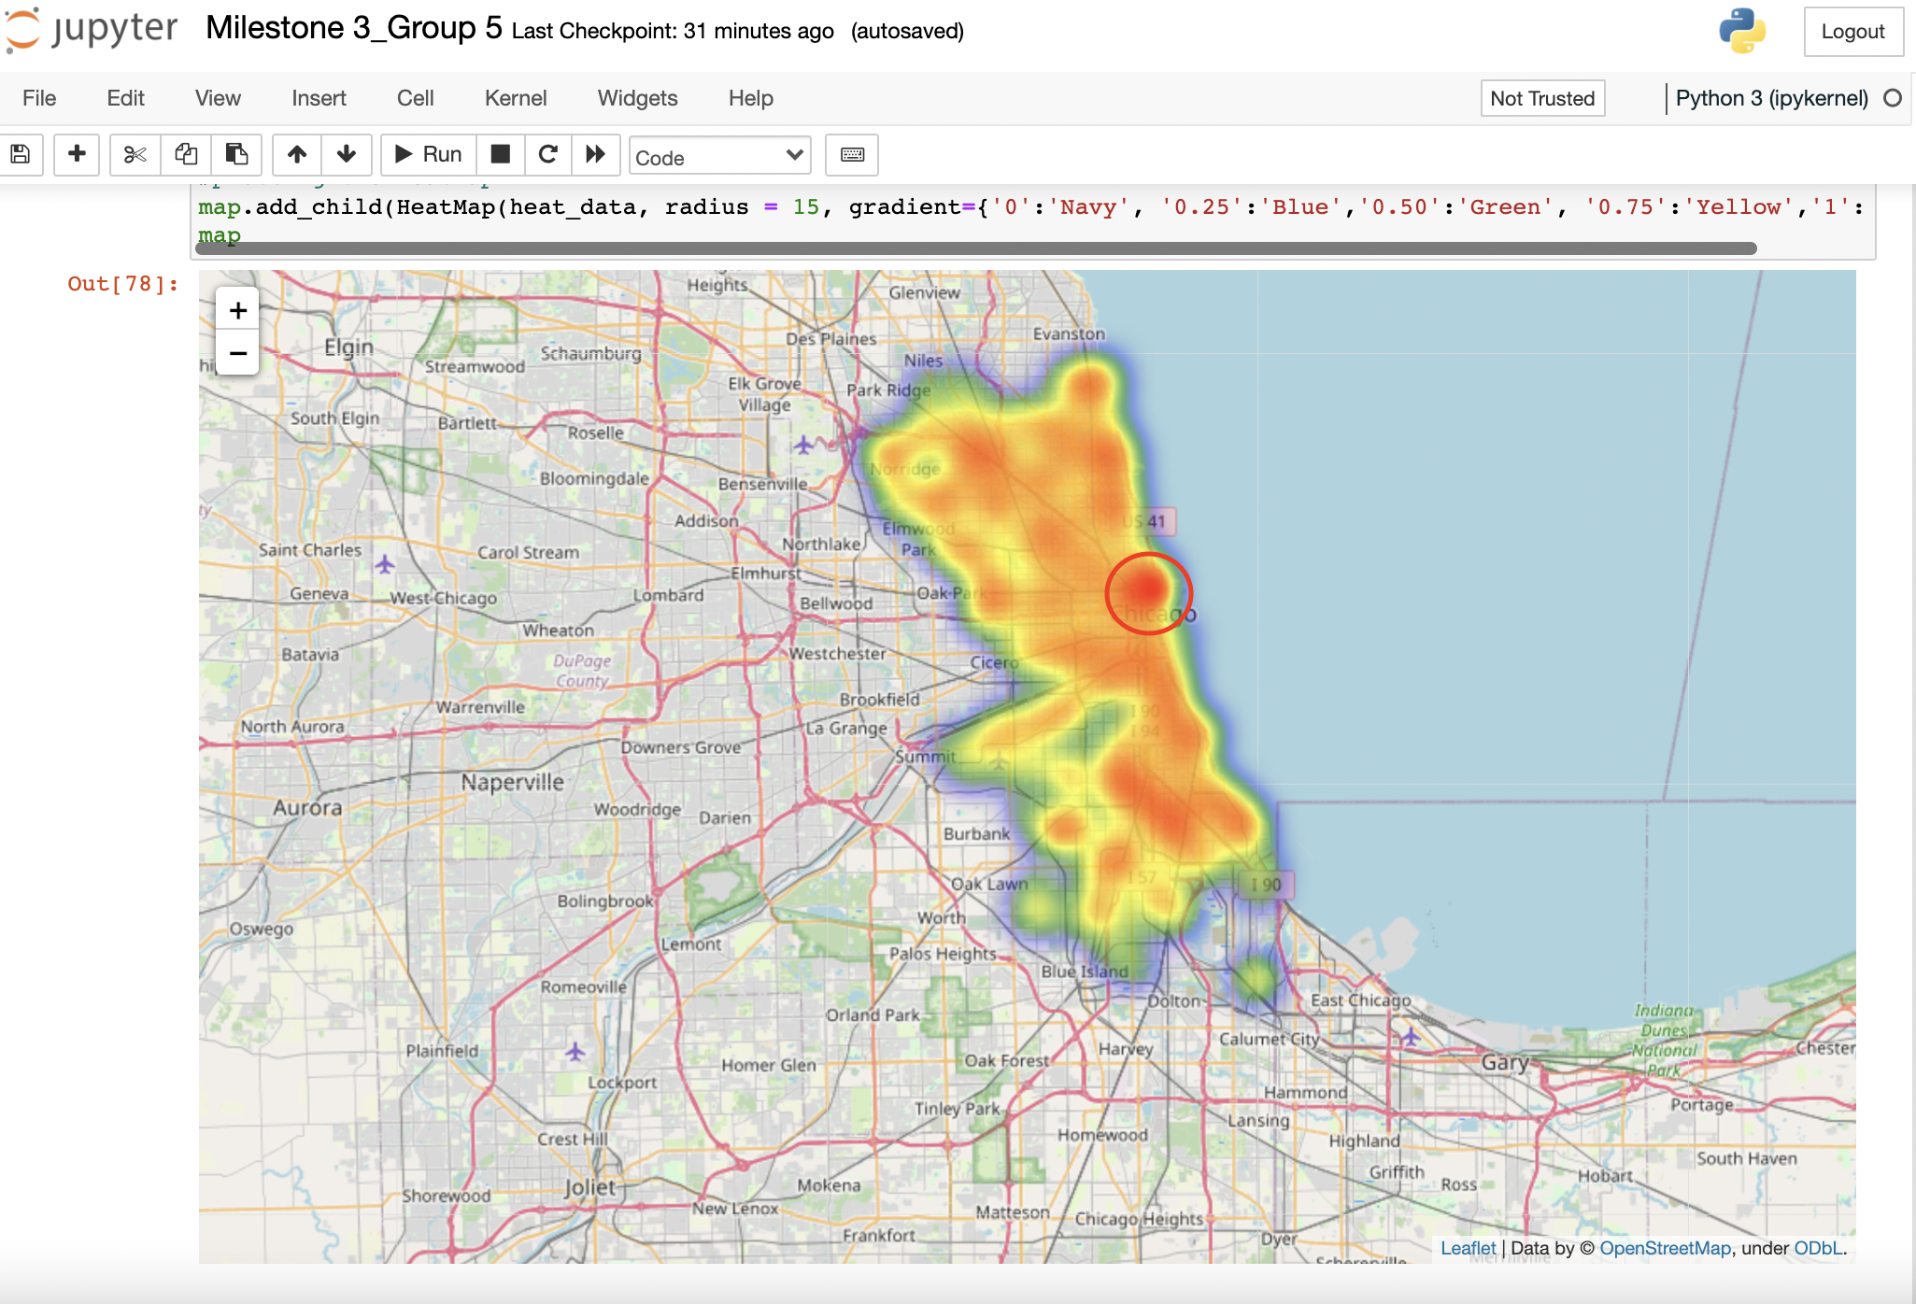
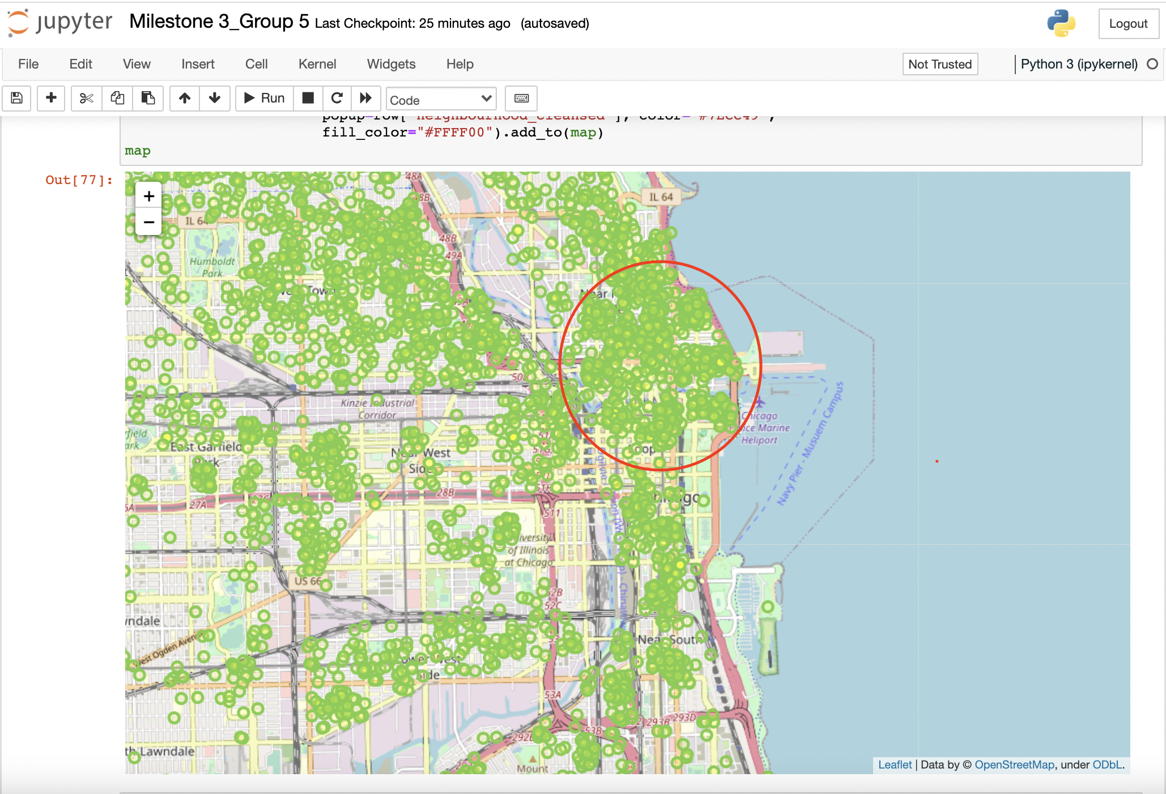
Data Visualization: Circle marker and Heat map
Using Folium, from folium import plugins, import Heatmap
Locations of all the properties listed by host based on latitude and longitude
Variables: latitude, longitude, neighbourhood_cleansed.
Maximum number of properties hosted by the hosts are located in the downtown of Chicago.
Latitude and longitude identifies the property location and listed price determines the intensity (high/low). The high-priced properties are located in the hotspots displayed on the map of Chicago. Highly visible hotspot in near the downtown.
Variables: latitude, longitude, price.

Slide 2
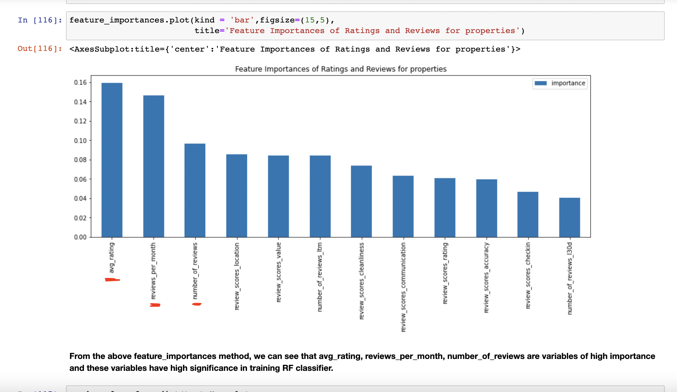
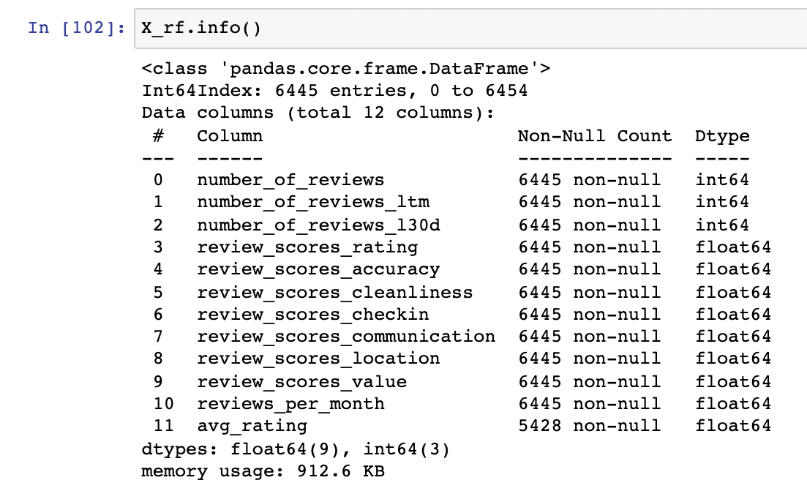
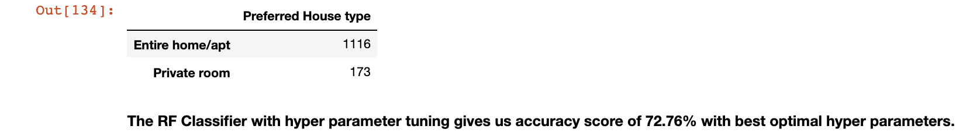
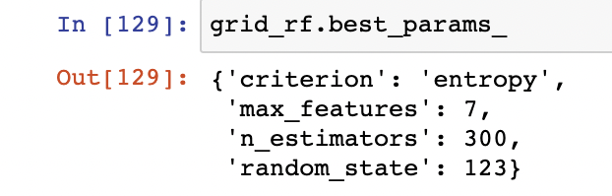
Predictive Model: Random Forest Classifier (predicting the most preferred room type for customers
Using sklearn.ensemble import RandomForestClassifier
Types of Rooms:
Private Room
Entire home/ apt
Hotel Room
Shared Room
Variables
Predictor variables: (11)
Dependent variable: (room_type) → categorical with 4 categories.
Data normalization: We used scaled predictors to increase the performance of the classifier.
Features_importance_ method defines the best predictors. We have avg_rating , reviews_per_month, number_of_reviews as best imp features.
Entire home/ apt is the most preferred amongst 4 room_types.

